Slide 1
What is the project?
VQA:
Asking Questions About Image Content
Tasfia Tabassum 1821391042 Ashfaq Uddin Ahmed 1911848042 S M Gazzali Arafat Nishan 1831513642
Visual Question Answering (VQA) is a relatively new problem in computer vision and natural language processing that has piqued the interest of deep learning, computer vision, and natural language processing researchers. VQA requires an algorithm to respond to text-based inquiries about photos. Because many open-ended replies comprise either a few words or a closed set of options that may be supplied in a multiple-choice format, VQA adapts itself to automated review.

Slide 2
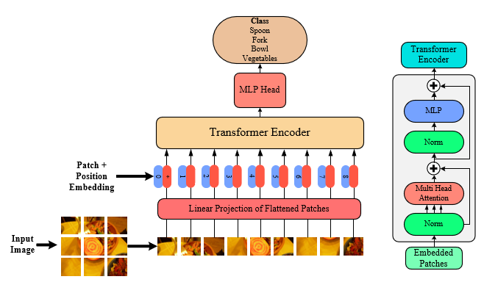
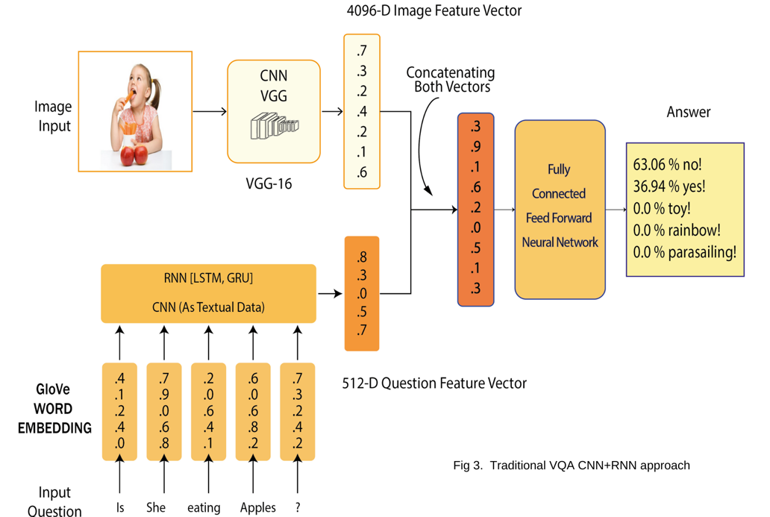
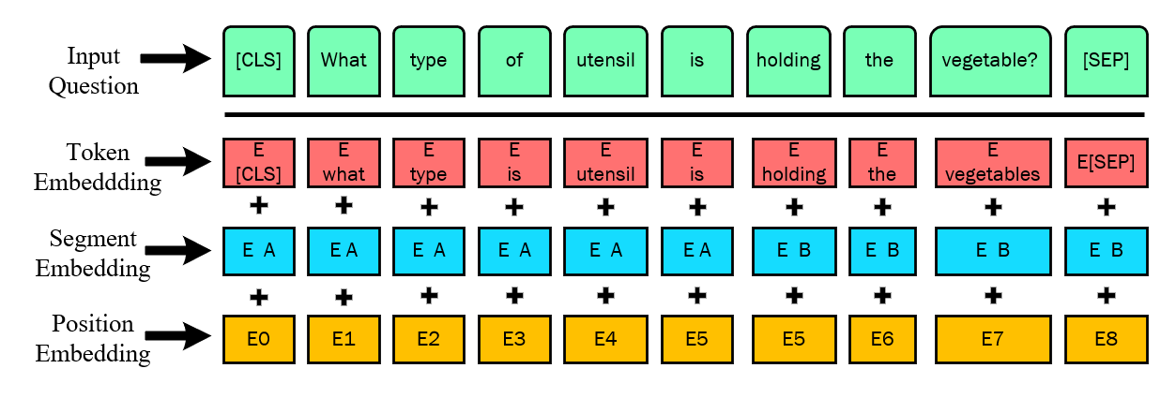
Analysis of the design principles
Fig. ViT Network Architecture
Fig. Traditional VQA CNN+RNN approach
Fig. BERT input Question Representation

Slide 3
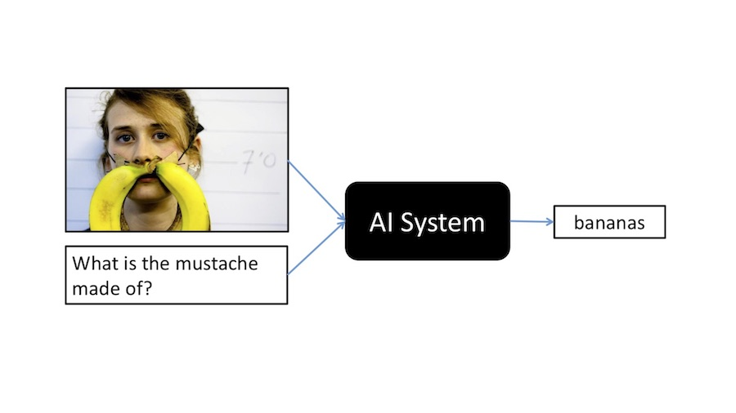

Usability, Manufacturability, Sustainability
Usability: User can simply pick an image from the internet place in the Image URL position, Type out the question and get the answer. Besides this the training and testing models are available in pro. People with simple Python Knowledge will easily understand it.
Manufacturability: Specifically, VQA can take center stage in computer vision, transforming numerous areas of the production. However our work can be deployed to a cloud based platform and be easily usable.
Sustainability: It is possible that our efforts is one small step in the right direction. Using pre-trained models this will drastically lower our electricity consumption.
Fig. VQA Usability
Fig. VQA Official Website https://visualqa.org/

Slide 4
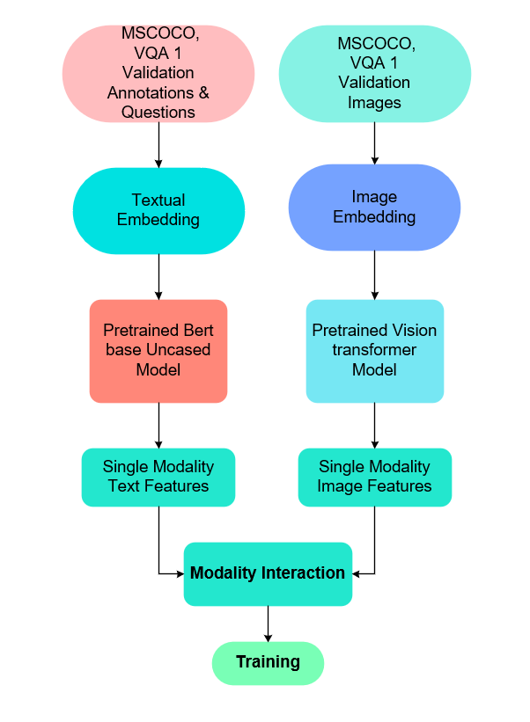
Implementation
A typical fusion model for a VQA system involves the following three steps:
Featurization of image and question: The Bert transformer is used to extract features from the question. Likewise, image features are retrieved using an image transformer (the Vision Transformer). For the traditional models, the question understanding part learns a dense question embedding feature vector to encode question semantics with the recurrent neural network (RNN) model. The vision part extracts visual features through a deep convolutional neural network (CNN).
Feature fusion: As VQA includes comparing the semantic information in the image and the question, the features from both modalities must be represented simultaneously. This is often performed through a fusion layer, which permits cross-modal interaction between image and text information to build a fused multimodal representation.
Answer generation: The answer generation part produces an answer conditioned by visual features and the question embeddings. The correct answers might be generated entirely using natural language using a basic classifier model for one-word answers in a defined response space. CNN-LSTM, CNN-GRU, CNN-VGG models were run for 100 epochs. ViT-BERT model ran for 20 epochs with epochs starting from 0.05.
Fig. Late Fusion Architecture of the system

Slide 5
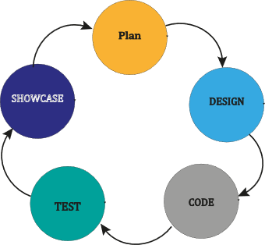
Development Process
For this project, we used an agile methodology.
As part of the agile process, tasks are divided into smaller iterations or components that have no direct impact on long-term planning.
We could stop for correcting our errors and solving them as well.

Slide 6

Environment Considerations & Sustainability
We used pre-trained model. This will drastically lower our electricity consumption.
Using Google Colab Pro
Google asserts that it has been carbon-neutral since 2007
Dataset from VQA V1 Validation(MSCOCO)
Images Scrapped from Flickr

Slide 7
Tools & Technologies Used
Our test framework was entirely done on Google Colab pro.
Use the keras module from tensorflow Keras is an open-source software library that provides a Python interface for artificial neural networks. Keras acts as an interface for the TensorFlow library.
Pre-trained VGG16, vgg_feast.mat is the file where we have pretrained model weights for the given dataset.
Tokenizers divide strings into lists of substrings. By tokenizing the data, you can minimize the locations where sensitive data is.
For the pre-trained BERT and ViT models, the Pytorch framework is employed.
We have imported AutoTokenizer, AutoFeatureExtractor from transformer packages.
Activation function: RELU,GELU.
To use the Wordnet, at first we installed the NLTK module, then download the WordNet package.
We have used two pretrained models from the Hugging Face AI community. To process the question, we have used text_model='bert-base-uncased' and for the Image processing ,we used image_model='google/vit-base-patch16-224-in21k'.
Since we modeled the VQA task as a multi-class classification, it is natural to use the "Cross-Entropy Loss" as the loss function.
For the performance metrics, we tried The Wu & Palmer similarity which is a metric to calculate the semantic similarity between two words or phrases.

Slide 8
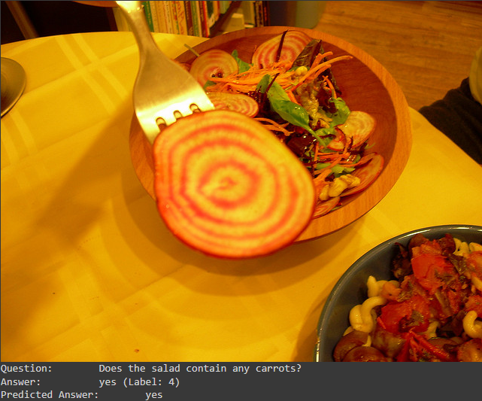

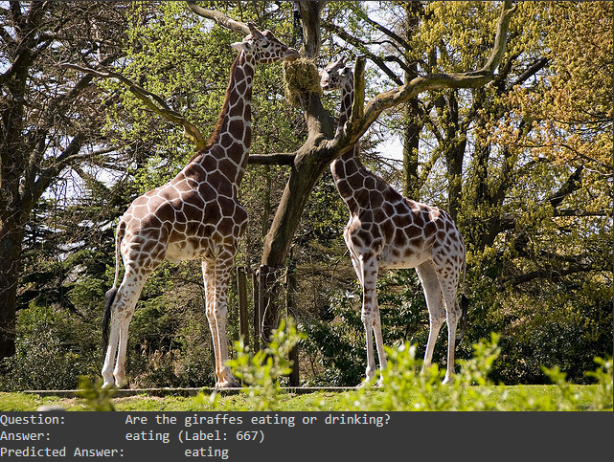

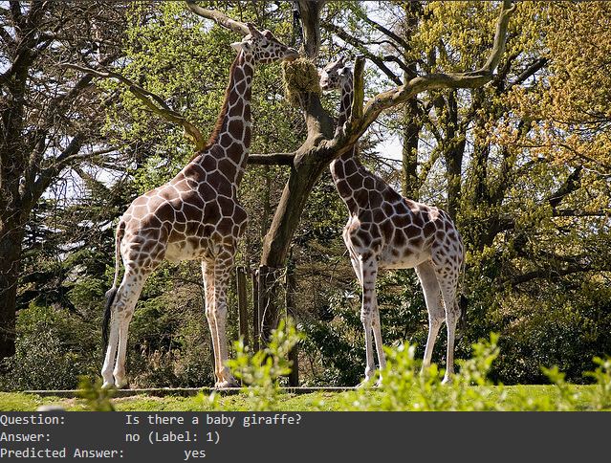
Results
On the official MSCOCO VQA dataset, we have successfully developed four VQA models, possibly the first to implement ViT and Bert
The output shapes of GRU and LSTM are the same.
Google claims that ViT-BERT beats state-of-the-art CNN with four times fewer CPU resources when trained on enough data
CNN seems to be much faster than RNN. CNN appears to be overfitting during training, but the model's test accuracy was satisfactory
Dataset | Model | Accuracy | Epoch
V1- VQA Validation | BERT-ViT | 0.46 | 20
V1- VQA Validation | LSTM-VGG | 0.43 | 100
V1- VQA Validation | GRU-VGG | 0.43 | 100
V1- VQA Validation | CNN-VGG | 0.44 | 100
Fig. ViT-BERT Model Predicting the answer when we pass the test samples through the model

